Slide 1


Analysis of Air Quality and Forecasting
Submitted by:
Himanshu Samal - 240343025018
Pritam Nimbalkar - 240343025038
Ritul Tayade - 240343025042
Shalu Sharma - 240343025045

Slide 2

Contents:
1
Problem Statement
7
Models Deployed
2
Data Description
8
Air Quality Forecasting
3
Technologies Implemented
9
Insights Boards
4
Workflow
10
Future Scope
5
Inference derived
11
Conclusions
6
Preprocessing

Slide 3


Problem Statement
1. Affects of the pollution on Rapidly developing countries like India.
2. Many Indian cities suffer worsening air quality despite control measures.
3. Millions of residents are impacted by poor air quality.
4. Understanding trends in air pollution levels is crucial for effective policy implementation.
5. Evaluating the effectiveness of pollution control measures is necessary.
6. Machine learning (ML) can analyze complex datasets to uncover patterns and make predictions.
7. Data driven insights can aid policy decisions and public health strategies.

Slide 4
OBJECTIVE
The objective of this project is to use machine learning and big data techniques to identify spatial and temporal patterns in air quality in India, uncovering hotspots and periods of high pollution. The insights gained will facilitate targeted interventions and inform policy decisions to mitigate air pollution and enhance environmental health.

Slide 5

Data Description
1. The dataset contains air quality data for Indian cities from the year 2010 to 2023.
2. It provides information about the air quality conditions in India.
3. The data has been collected from the Central Control Room for Air Quality Management,
which indicates that it is a reliable and authoritative source.

Slide 6
Data Description
Parameters: The dataset likely includes key air quality parameters such as PM2.5 (particulate matter 2.5 micrometers or smaller), PM10, NO2 (nitrogen dioxide), SO2 (sulphur dioxide), CO (carbon monoxide), O3 (ozone), and meteorological factors like temperature, humidity, wind speed, etc.

Slide 7




Technology Implemented
Machine
Learning

Slide 8



Workflow
Dataset
Data Cleaning
Data Visualization
Hive
Machine Learning
Pre-processing

Slide 9

Inference
Derived

Slide 10
health effects.
Air Quality Index
The Air Quality Index (AQI) is a key indicator used by governmentssand environmental agencies worldwide to communicate the quality of air to the public ,
AQI Range: 0-500, where 0 indicates good air quality and 500 indicates severe pollution.
Major Pollutants: PM10, PM2.5, CO, CO2, NO2, SO2, NH3.
Minimum Data Requirement: Data for at least three pollutants is needed to calculate AQI, with at least one being PM10 or PM2.5.
Health Effects: Each AQI range corresponds to different pollutant concentrations and associated health effects.
This information has been used to add the AQI column as the target column in your dataset for inference.
The Air Quality Index (AQI) is a key indicator used by governments and environmental agccdencies worldwide to communicate the quality of air to the public.

Slide 11
Preprocessing
Data Cleaning:
Handling Missing Values: Techniques for filling in or interpolating missing data.
Outlier Detection: Identifying and managing anomalies in the data.
Feature Scaling:
Normalization or Standardization: Scaling features to ensure they contribute equally to model performance.
Data Transformation:
Temporal Aggregation: Aggregating data into daily, weekly, or monthly summaries.
Feature Engineering: Creating new features based on existing data, such as pollution indices or combined meteorological factors.
Data Splitting
Training and Testing Sets: Dividing the data into training and testing sets for model evaluation.

Slide 12

Models Deployed

Slide 13
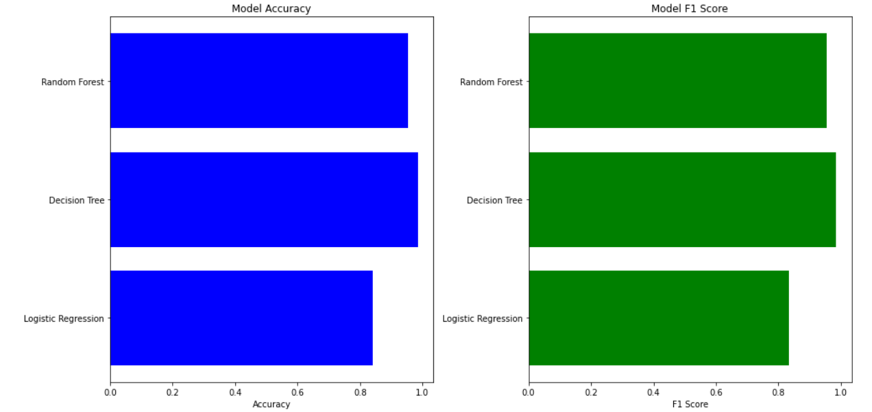
Model Performance Summary
Models Evaluated: Decision Tree, Random Forest, and Logistic Regression.
Decision Tree achieved the highest performance with an Accuracy of 97.67%, indicating superior predictive accuracy and precision.
Random Forest also demonstrated strong performance with an Accuracy of 95.87%, reflecting its robustness.
Logistic Regression yielded a Accuracy of 78.46%, showing less effectiveness in comparison to the tree-based models.

Slide 14
ARIMA Model Application
Arima is designed for forecasting by capturing temporal patterns, unlike traditional machine learning models which do not directly account for time-based structures.
we have Applied ARIMA to forecast future PM10 levels from historical data.

Slide 15
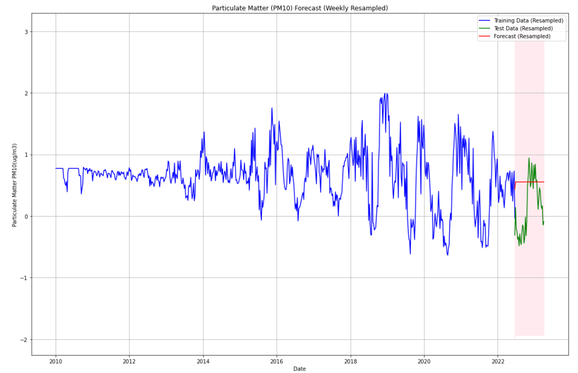
Air Quality Forecasting

Slide 16
Insights
Boards

Slide 17
Future Scope
Enhanced Machine Learning Models: Explore advanced machine learning algorithms and models to further improve prediction accuracy and robustness. Investigate deep learning approaches to capture intricate patterns in the meteorological data.
Real-time Data Processing: Integrate real-time data processing capabilities to provide users with the most up-to-date information. This could involve adopting streaming analytics technologies and continuous model training.
Integration with Additional Data Sources: Expand the project's scope by integrating data from additional sources, such as satellite imagery or other meteorological databases. This diversification could lead to a more comprehensive understanding of environmental conditions.

Slide 18
Conclusion
Our project represents a sophisticated and comprehensive system for predicting and analyzing meteorological data across India.
The integration of Python, PySpark,and Tableau Public facilitated a robust and scalable infrastructure for data retrieval, preprocessing, machine learning modeling, and user interaction.
Our findings provide a foundation for developing targeted strategies and policies aimed at improving air quality and ensuring a healthier environment.

